Slide 1



Day 23
contact@anubhavtrainings.com
ABAP RESTFUL APPLICATION PROGRAMMING

Slide 2

Agenda – Day 23
History of ABAP on Cloud
Motivation for ABAP on Cloud – Scenario
Create your first program in ABAP on Cloud
Creating Database tables – Business Partner, product, Sales Order, Sales Order Items
Creating CDS Views – Using VDM Recap
Limitations of ABAP on Cloud

Slide 3
History of ABAP on Cloud
2020 - September
Support for eTag and Draft
Managed Scenario Released in On-premise S/4HANA 2020
2019 - September
A Trial offered in Cloud Platform CF environment
Between 2018-19
ABAP RESTful Programming Model
2018
General availability of Cloud Platform ABAP Environment
2017
Announcement of ABAP on Cloud

Slide 4
Motivation for ABAP on Cloud
ECC /
Business Suite
S/4HANA
1909 OP
Yearly
S/4HANA
Cloud
1908
Quarter
Custom Apps or
Extend
SAP NetWeaver 7.5x ABAP Layer
ABA Layer
RESTful Application Programming Model
SAP Cloud Platform
Java, Node.js
HANA, ABAP
Any DB/HANA
HANA

Slide 5



Motivation for ABAP on Cloud
Fiori UX
Leverage HANA
Build Transactional Fiori Apps
Responsive Web Design
Squeeze the power of in-memory
DB with Code-to-data
ABAP in Cloud
Robust programming with ABAP
Cloud Ready Extension
Utilize your ABAP skills to
develop cloud native apps
Side-by-side extension scenarios
using Cloud solutions

Slide 6

Challenges (in context of cloud)
Integration between new solutions
Adoption of new trends like ML, IoT, Big data
People, process and information integration
Speed of innovation
Extend existing solutions
Bi-Model IT
Stable Core
Innovation
SAP Business Technology Platform
Is here…
Remember “You are not building platform, you will use platform to build/integrate on top of it”

Slide 7
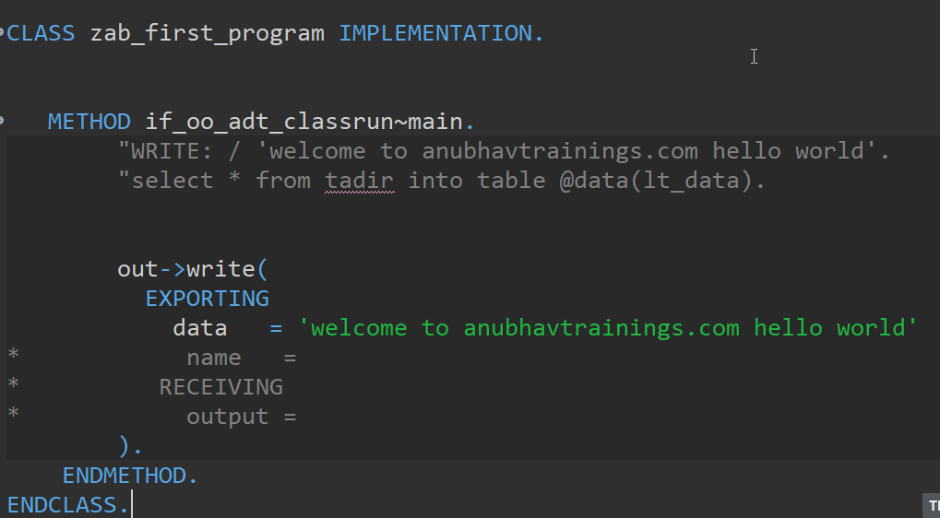
Create your first program

Slide 8
Create Your DB Tables
Business Partner
Sales Order Header
Sales Order Items
1..1
1..*
Product
1..1
Exercise
Create Data elements & Domain for ID (Char32) and Role (Char2)
Create Database Tables
Load Data to the table

Slide 9
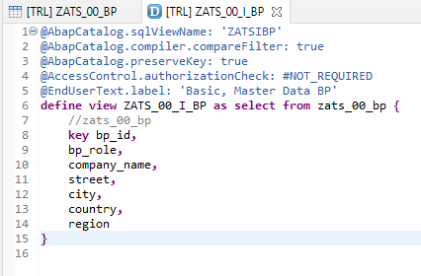
Creating CDS View
Exercise :-
CDS View Code

Slide 10
Limitation’s of ABAP on Cloud
It is an offering by SAP in SAP BTP platform as ABAP Platform as a service, which has limited capability.
https://blogs.sap.com/2019/08/20/its-steampunk-now/
We cannot use SAPGUI to connect to this system
We do not have control to install patches and add-on, snote
It is not an environment of any SAP ERP solutions
All the ABAP dictionary objects are marked as non-released
SAP’s actual product is S/4HANA, so all the classical extensions will be carried out in S4 itself.
You cannot create a program type of object
The AOC allows only usage of whitelisted abap statements, we cannot freely use every abap programming keyword.
Note : Eclipse environment can be used to connect to ABAP Environment in SAP Cloud platform

Slide 11
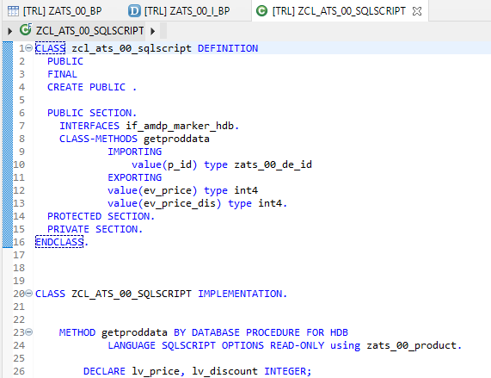
Creating AMDP
Exercise :-
AMDP Code

Slide 12

End of Day 23
Trainer: Anubhav Oberoy

Slide 13

Trainer: Anubhav Oberoy

Slide 14
THANK YOU
If you cannot do
great things, do small things in a great way.
Anubhav Oberoy
https://www.anubhavtrainings.com

Slide 15


We’re committed to empower you to be
Most Desirable Resource
through powerful training solutions.
We build the workforce of the future.
250+
Corporate Clients
30,000+
Learners Trained
25000+
Learners Placed
FREE WEBINARS
Sign up for free webinars with industry experts every fortnight!
Enroll Now!
Contact us today!
https://anubhavtrainings.com/

Slide 16




More from AnubhavTrainings.com

